Slide 1



Slide 2



 | Slope Bins 4 | Smear Count 25
Block number | Alpha w/ Henderson Hasselbalch | Chi Chi_max = 2.2
[0 50] | 0.040012 | 1.160000
[50 75] | -0.278451 | 0.720000
[75 125] | -0.519707 | 0.608000
[125 156] | -0.154453 | 0.529032

Slide 3


 | Slope Bins 4 | Smear Count 31
Block number | Alpha w/ Henderson Hasselbalch | Chi Chi_max = 2.2
[0 31] | 0.001103 | 0.922581
[31 62] | -0.386873 | 0.703226
[62 93] | -0.290146 | 0.967742
[93 496] | 0.037164 | 1.098759
[496 527] | -0.064533 | 0.819355
[527 620] | 0.010682 | 0.756989
[620 647] | -0.103326 | 0.696296

Slide 4
Approach
B, and v will be different for L and H
Chi should be same
Match pure L and H first, then mix
SCFT Purpose:
Additional information of underlying protein organization
Possible underlying conformational change driven by Cs

Slide 5
Summary

Slide 6









b2.0 v2.7 c3.2
b3.0 v3.5 c3.5
b3.0 v7.0 c3.5
b3.0 v7.0 c3.0
Phi too small
Phi too small to decrease v0
b4.0 v12.0 c3.0
b5.0 v20.0 c3.0
b5.0 v20.0 c4.0
b5.0 v5.0 c3.0
b5.0 v10.0 c3.0
Phi too small to decrease v0

Slide 7

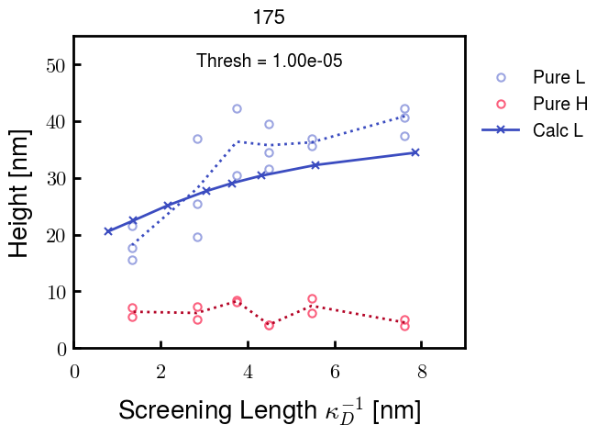
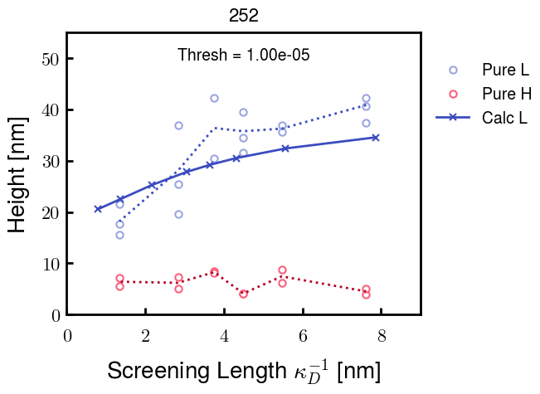



v2.7 and some fine
b1.50 v2.7 c3.2
b1.75 v2.7 c3.2
b1.75 v2.5 c3.2
b1.75 v2.5 c3.0
b2.0 v2.7 c3.2
b2.25 v2.7 c3.2
b2.50 v2.7 c3.2

Slide 8






v20
b5.0 v20.0 c3.0
b4.5 v20.0 c3.0
b4.0 v20.0 c3.0
b3.5 v20.0 c3.0
v10
b5.0 v10.0 c3.0
b4.0 v10.0 c3.0
b3.0 v10.0 c3.0
b2.0 v10.0 c3.0

Slide 10




b2.00 v2.70 c3.20
b2.00 v2.75 c3.20

Slide 11
NFH fitting (from NFL best fit)

Slide 12








b1.00, v0.50, c3.2
b2.00, v4.00, c3.2, th2.5e-02
b1.00, v2.00, c3.2
b1.00, v1.00, c3.2

Slide 13
Mixture

Slide 14



Slide 15


b = 0.75

Slide 16





Slide 17
b = 1.0

Slide 18





Slide 19
b = 1.25

Slide 20




Chi 2.6
Bad vol frac

Slide 21








b25v0
b25v1
b25v2
b25v3

Slide 22




Chi 2.8
Bad vol frac

Slide 23





Slide 24
b = 1.50

Slide 25






Chi 2.8
Bad vol frac

Slide 26





Slide 27

b = 2.00
v4 = 0.25*b^3

Slide 28


Bad vol frac

Slide 29



Slide 30
Fine tune

Slide 31



b1.25, v1.95, c3.0
b1.50, v3.38, c3.0
b2.00, v4.00, c3.0
Norm seems to capture kinked behavior

Slide 32




Slide 33



b1.25, v1.95, c3.2
b1.50, v3.38, c3.2
b2.00, v4.00, c3.2

Slide 34




Slide 35


b1.25
b1.50
b2.00
c2.8
c3.0
c3.2

